Slide 1
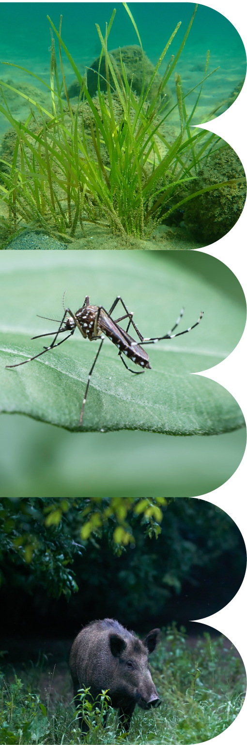

BioHackrXiv
Slides provided by Leyla Jael Castro, Pjotr Prins and team
Hackathon/2 April 2024

Slide 2
BioHackrXiv

Slide 3

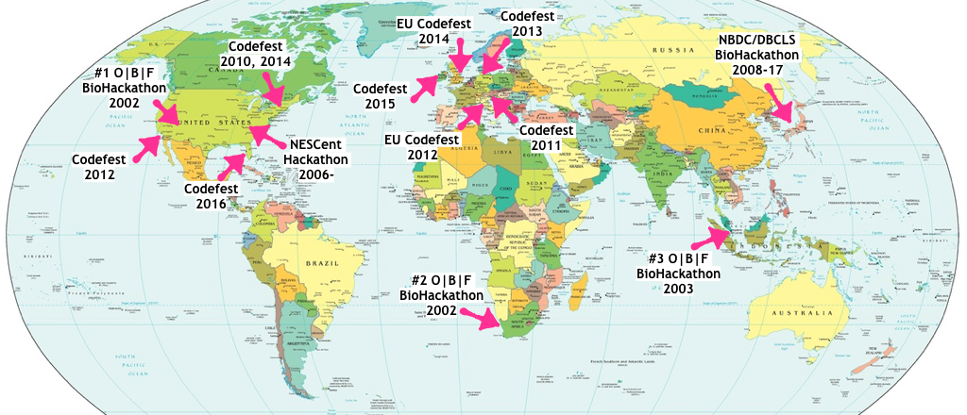
How do we get started the BioHackathon?
BioHackathon was originally introduced by the O|B|F in 2002
BioPerl
BioRuby
Biopython
BioJava
:
Interoperability of Open Bio* libraries for accessing DBs

Slide 4
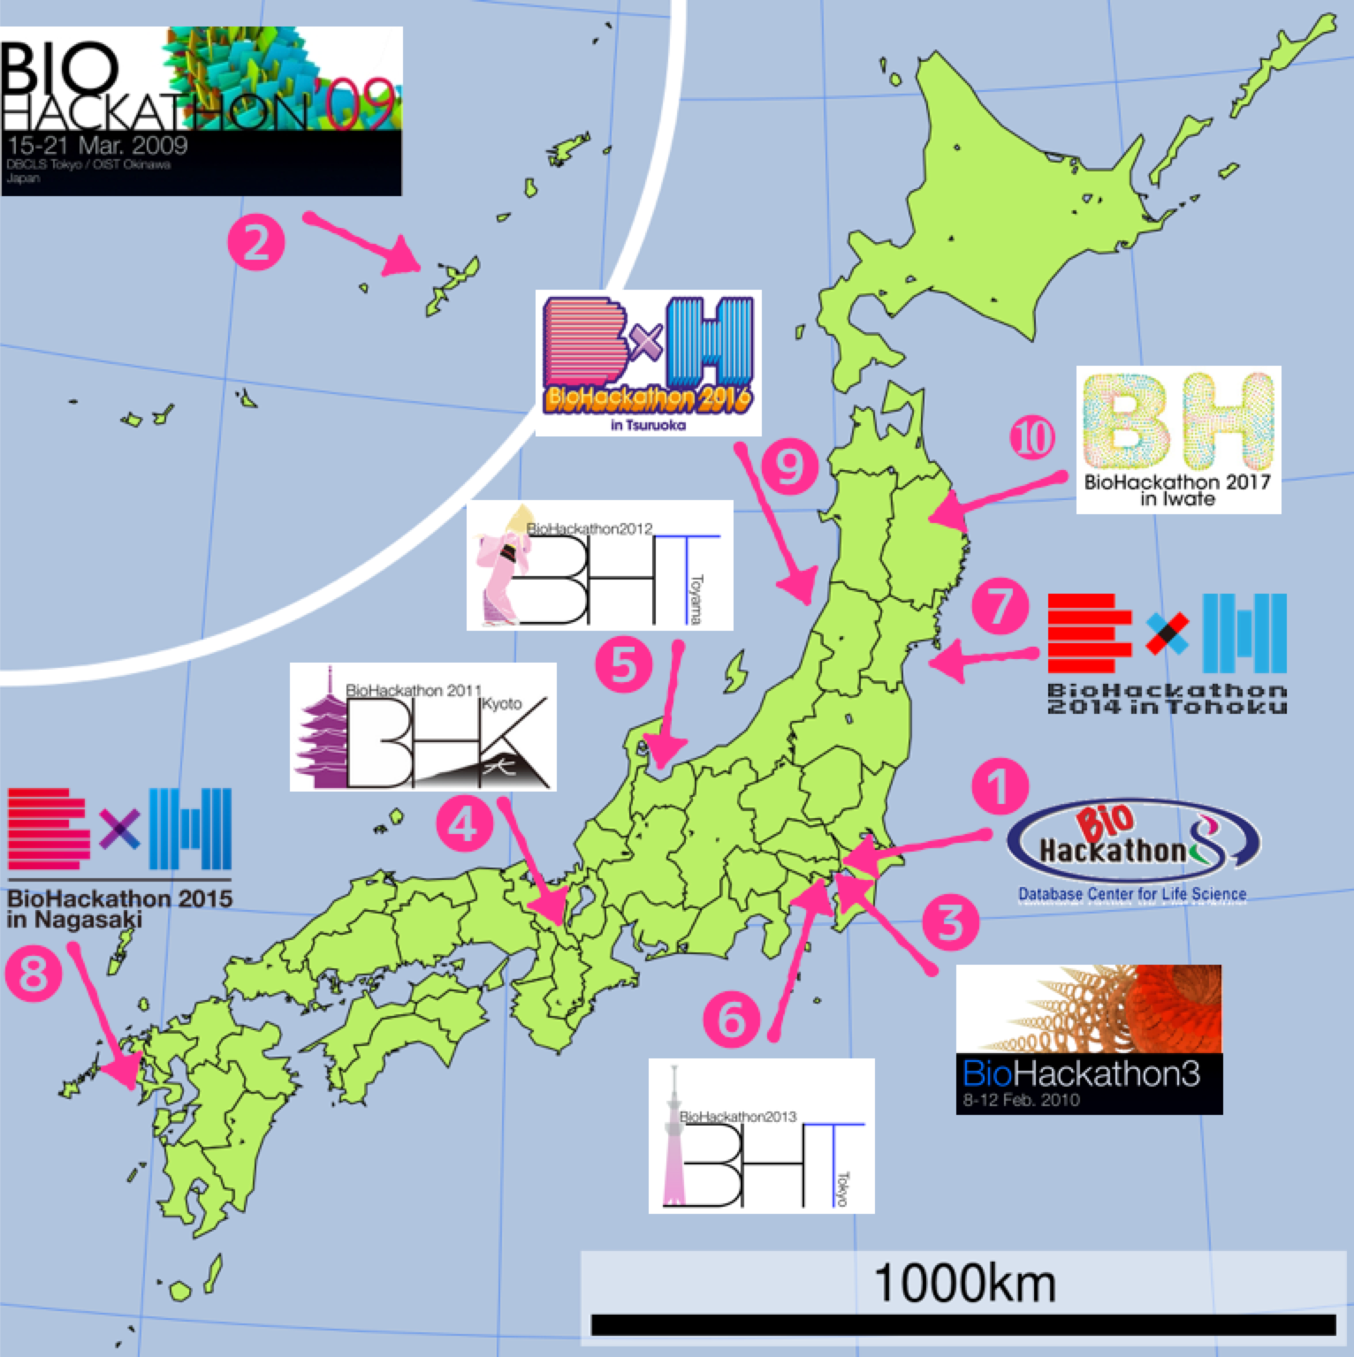

History of the NBDC/DBCLS and ELIXIR BioHackathon
O|B|F BioHackathon 2002-2003
Interoperability of Open Bio* libraries
DBCLS BioHackathon 2008-2010
Integration of distributed bioinformatics resources with Web Services
NBDC/DBCLS BioHackathon 2010-2019
Integration of distributed bioinformatics database contents with Semantic Web
ELIXIR BioHackathon 2018-2019
Newly started in collaboration!

Slide 5
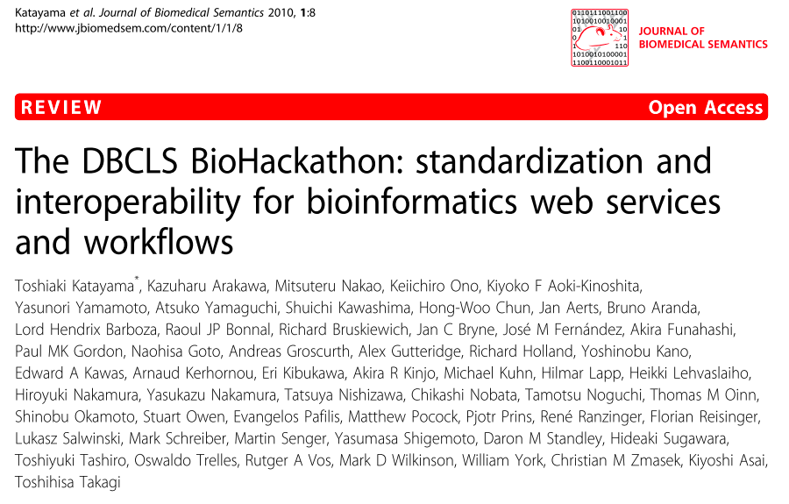
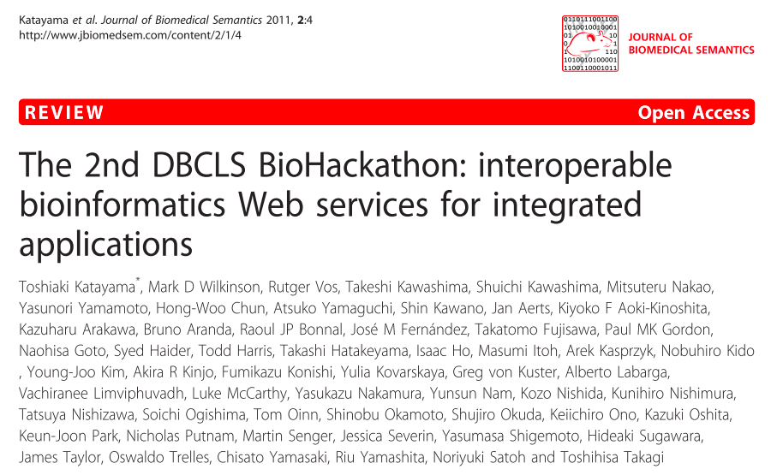
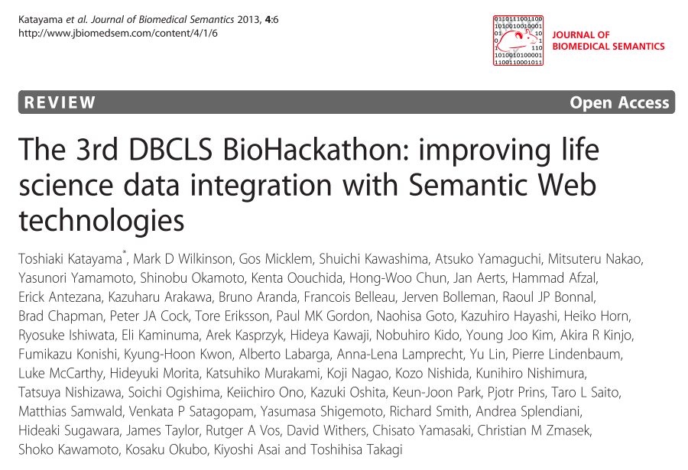
Publications from the previous BioHackathons
BioHackathon 2008 published in 2010 @ JBMS
BioHackathon 2009 published in 2011 @ JBMS
BioHackathon 2010 published in 2013 @ JBMS

Slide 6
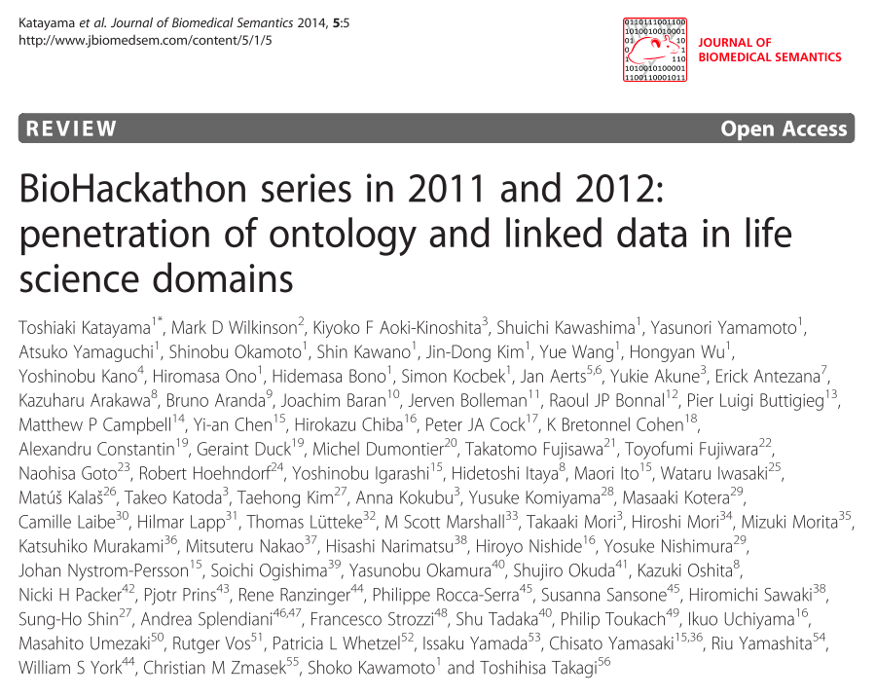
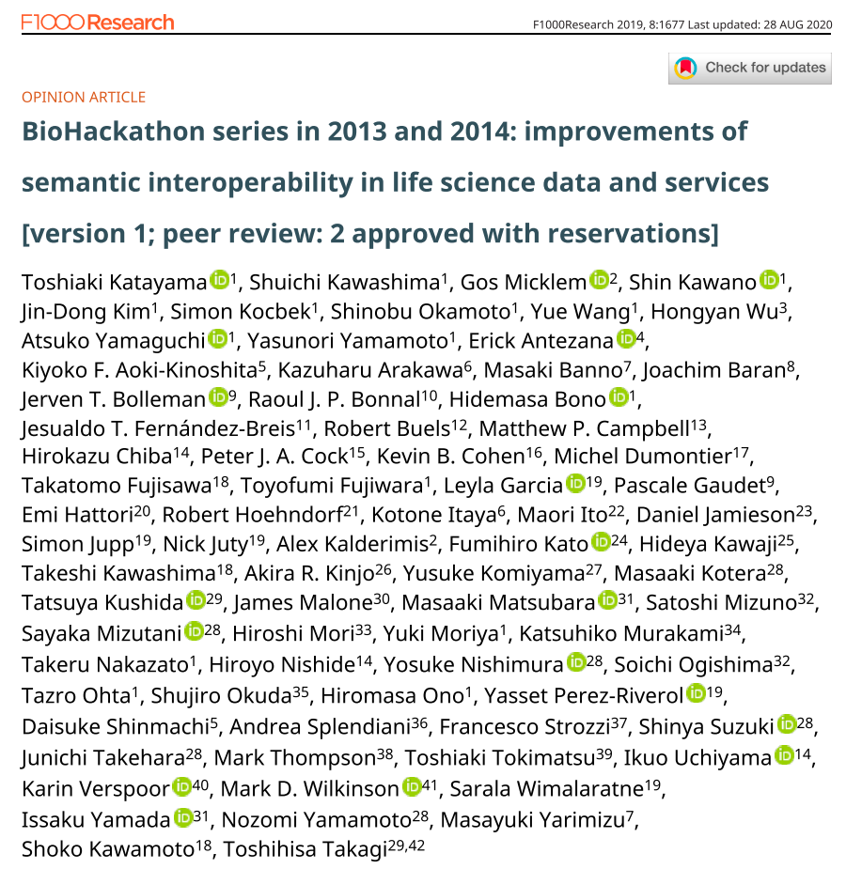
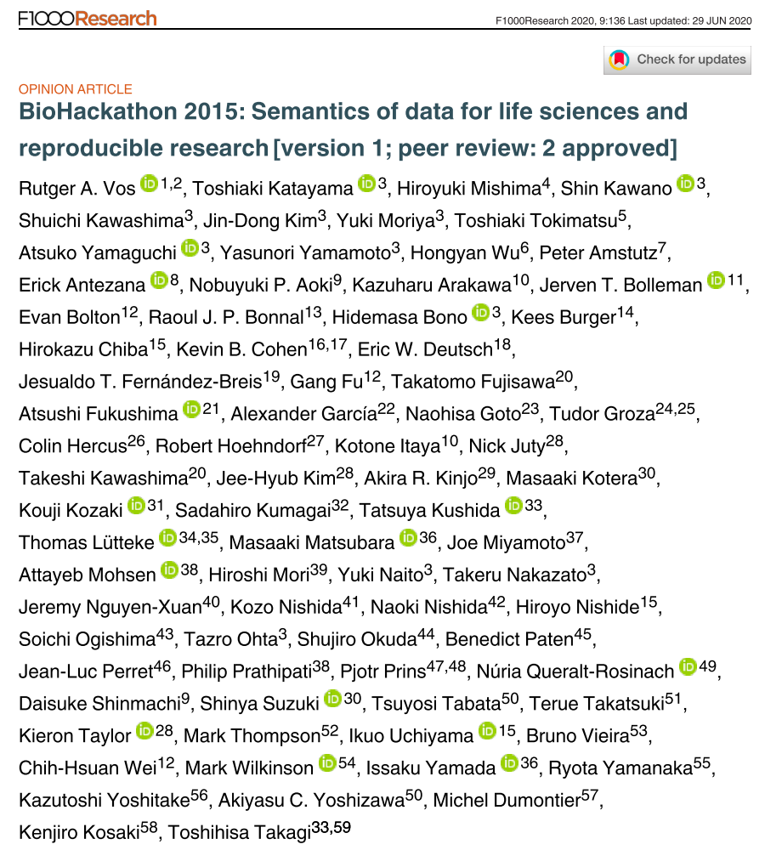
Publications from the previous BioHackathons
BioHackathon 2011-2012 published in 2014 @ JBMS
BioHackathon 2013-2014 published in 2019 @ F1000 Res
BioHackathon 2015 published in 2019 @ F1000 Res

Slide 7
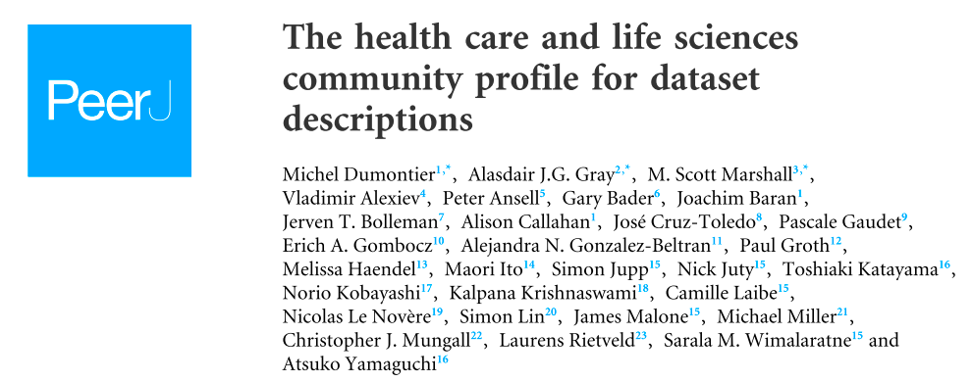

Sister publications from the previous BioHackathons
FALDO (Feature Annotation Location Description Ontology)
HCLS (The health care and life sciences community profile for dataset descriptions)
Identifiers.org (SPARQL-enabled identifier conversion)
:

Slide 8
Publication has been a burden for the past BioHackathons
It took over a year to summarize the results
Hard to streamline the story from >20〜40 heterogeneous groups' results
Reviewers request scientific outcomes
Reviewed not as a review paper / conference report but as a full paper
Existing preprint servers don't receive BH reports
bioRxiv etc.

Slide 9
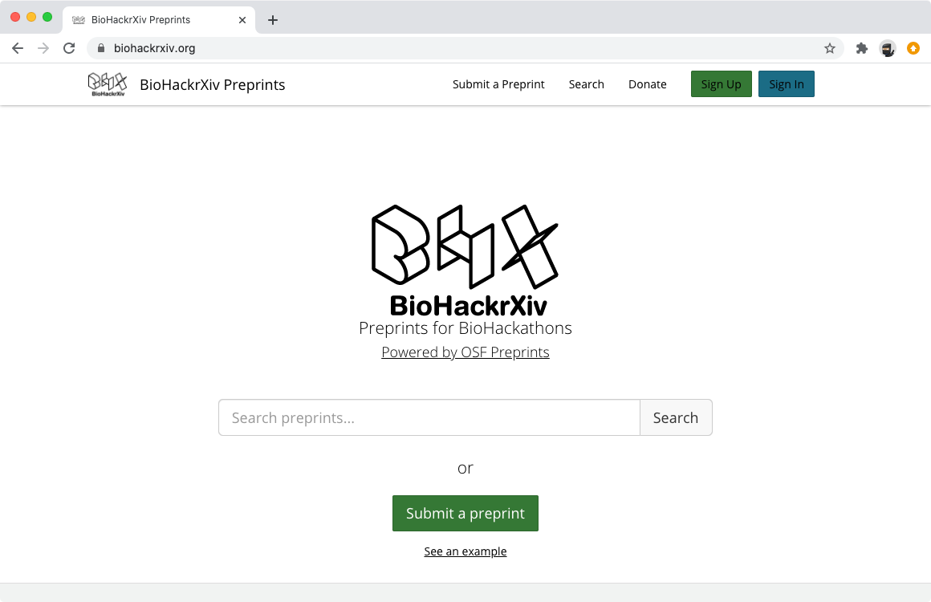
You are welcome to submit your results to the BioHackrXiv
Started at the 12th NBDC/DBCLS BioHackathon in 2019
Brand new preprint server dedicated to the BioHackathons
We accept any results from BioHackathons
NBDC/DBCLS BioHackathons
ELIXIR BioHackathons
& any other hackathons/codefests that committee members agreed
Hosted at Open Science Foundation (OSF)
https://biohackrxiv.org/
$1,000 / year (currently covered by DBCLS)
Markdown format is our native syntax
Markdown to PDF converter is provided
http://preview.biohackrxiv.org/
No need to aggregate
Publish your results independent from others

Slide 10
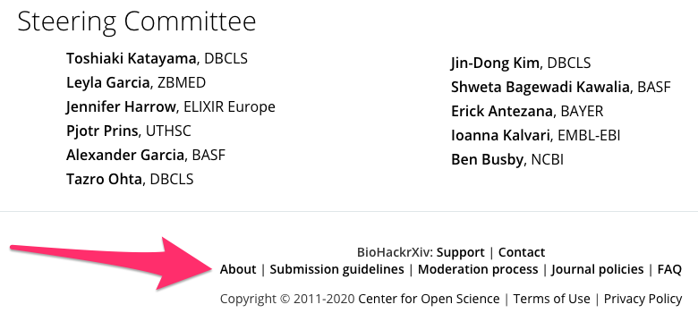
Guidelines for submitters
About
http://guide.biohackrxiv.org/about.html
Submission guidelines
http://guide.biohackrxiv.org/submission_guidelines.html
Moderation process
http://guide.biohackrxiv.org/moderation_process.html
Journal policies
http://guide.biohackrxiv.org/journal_policies.html
FAQ
http://guide.biohackrxiv.org/faq.html
Links to these documents can be found at the bottom of the BioHackrXiv website.
You are also welcome to be a committee member if you run a BioHackathon or a Codefest

Slide 11
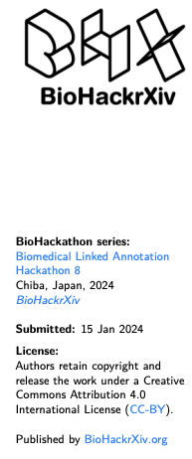
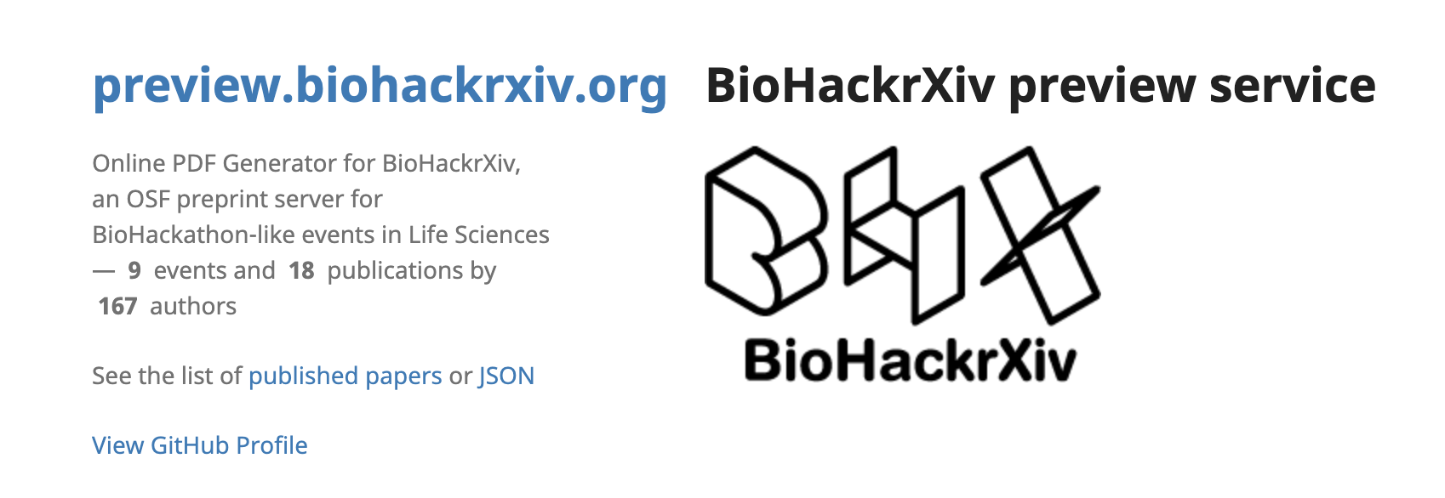
Submit your project report to BioHackrXiv!
https://biohackrxiv.org
A preprint server developed and run by volunteers from the past BH series
only for the approved hackathon events - and BLAH8 is in the list!
How to:
1. Create a new GitHub repository
2. Write your report in a markdown file named ‘paper.md’ in root dir
template is available (thx to Leyla!)
3. Put the repository URL to http://preview.biohackrxiv.org and get your paper compiled
4. Submit to https://biohackrxiv.org

Slide 12
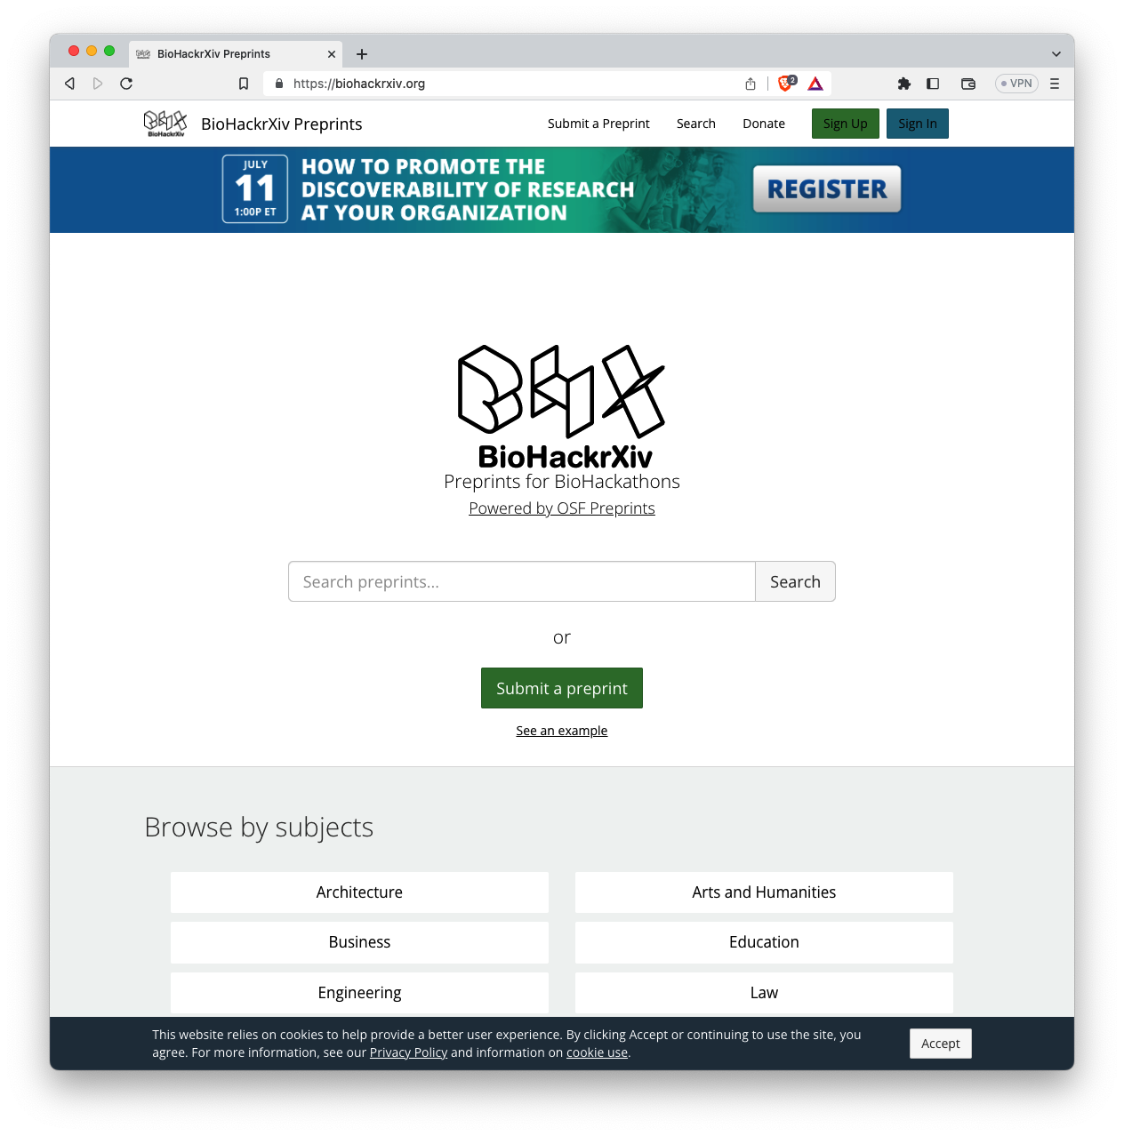
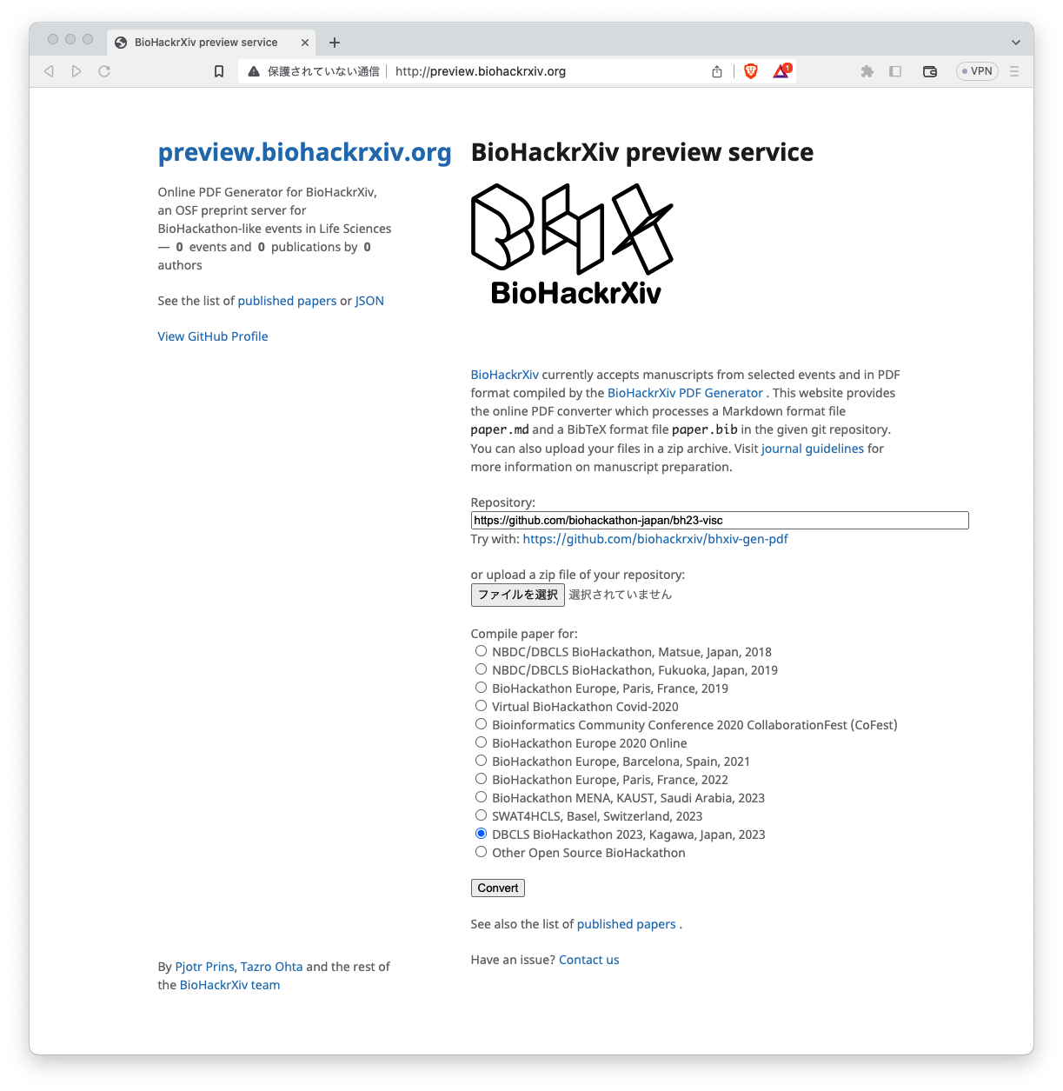
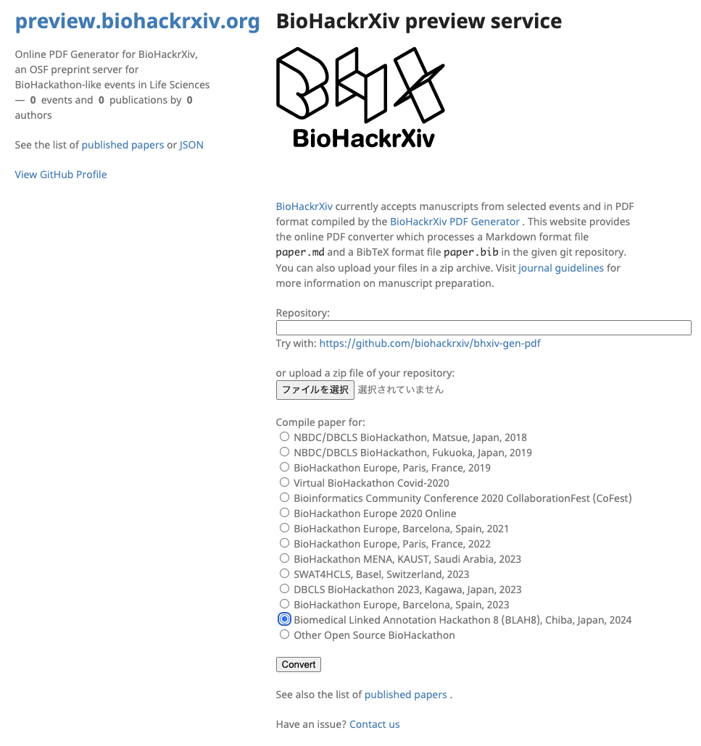
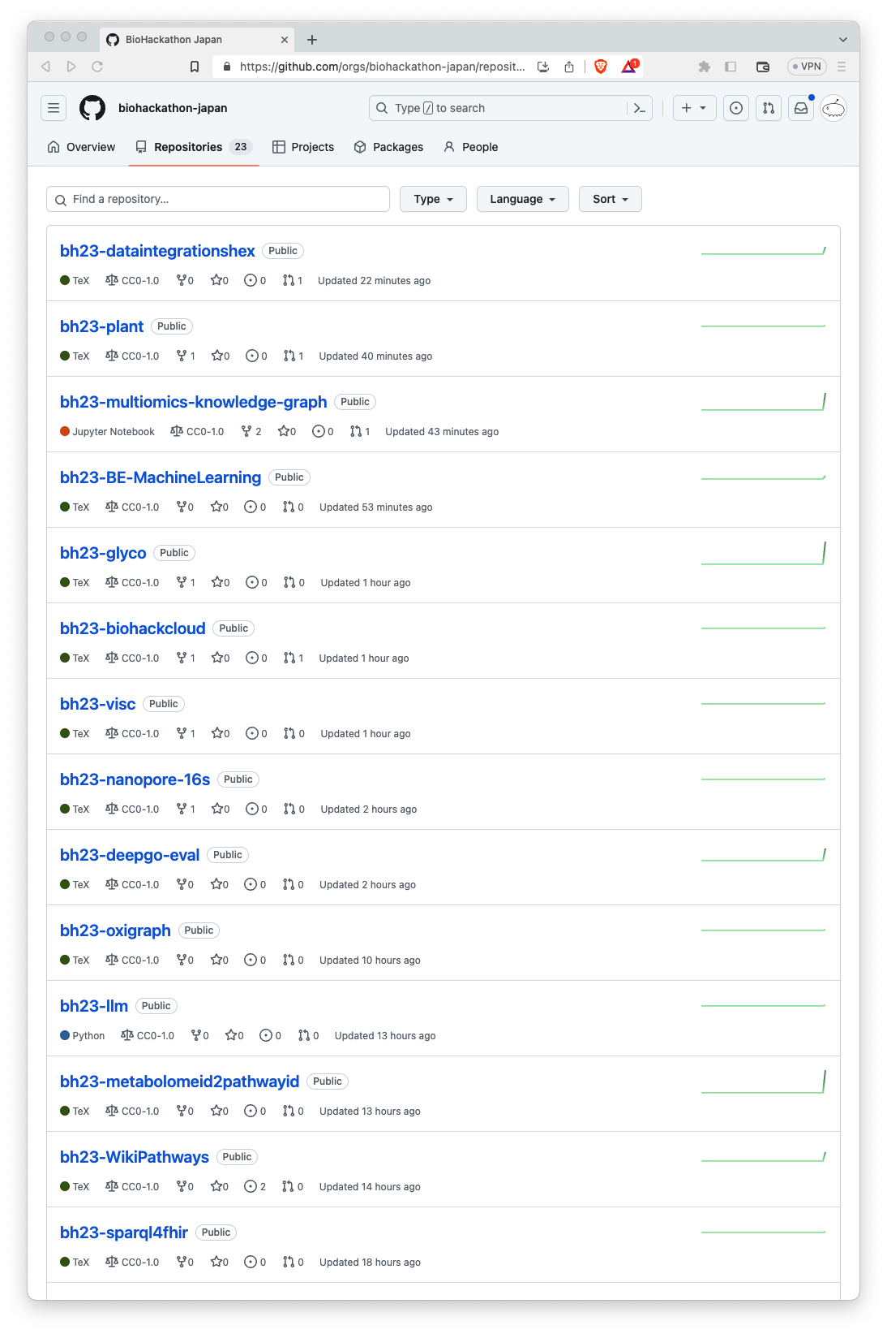
https://biohackrxiv.org/
https://github.com/biohackathon-japan
http://preview.biohackrxiv.org/

